Slide 1

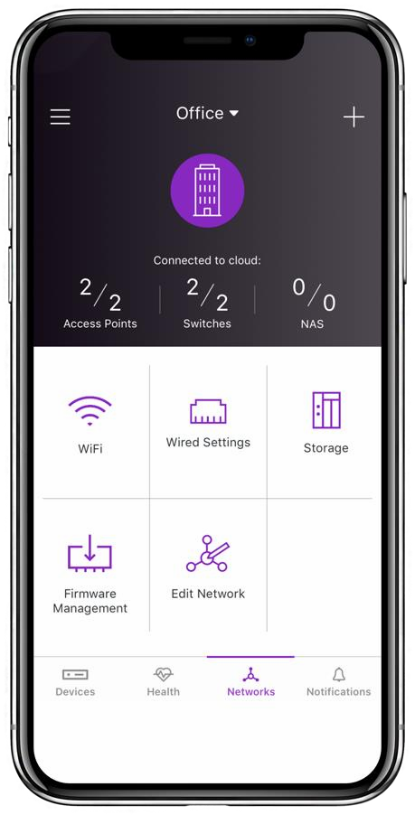


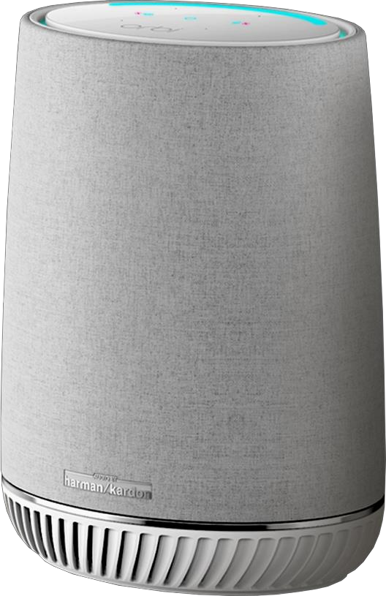
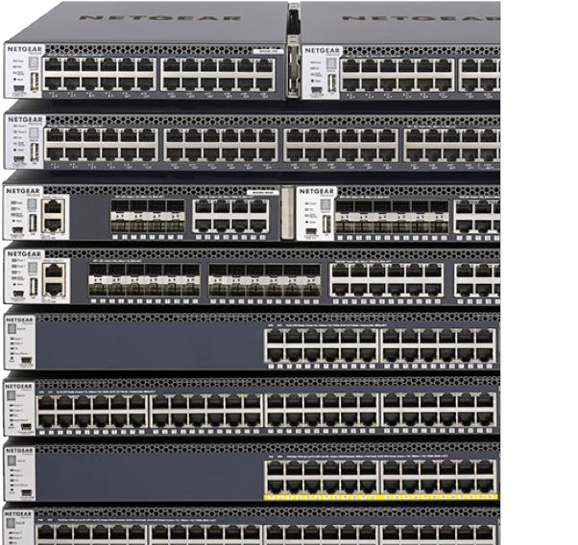
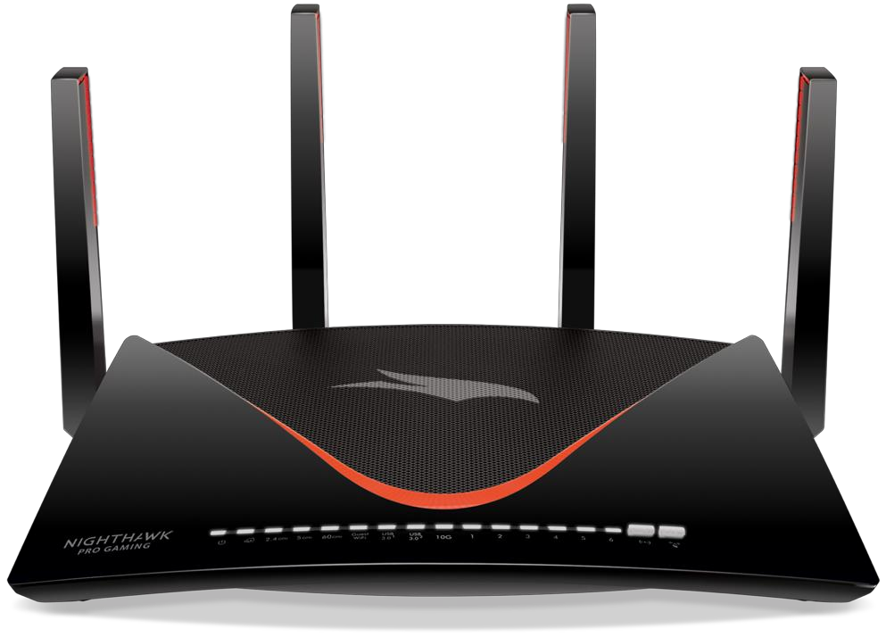
Cost of Complexity - CHP
Final Presentation, February 8, 2019

Slide 2
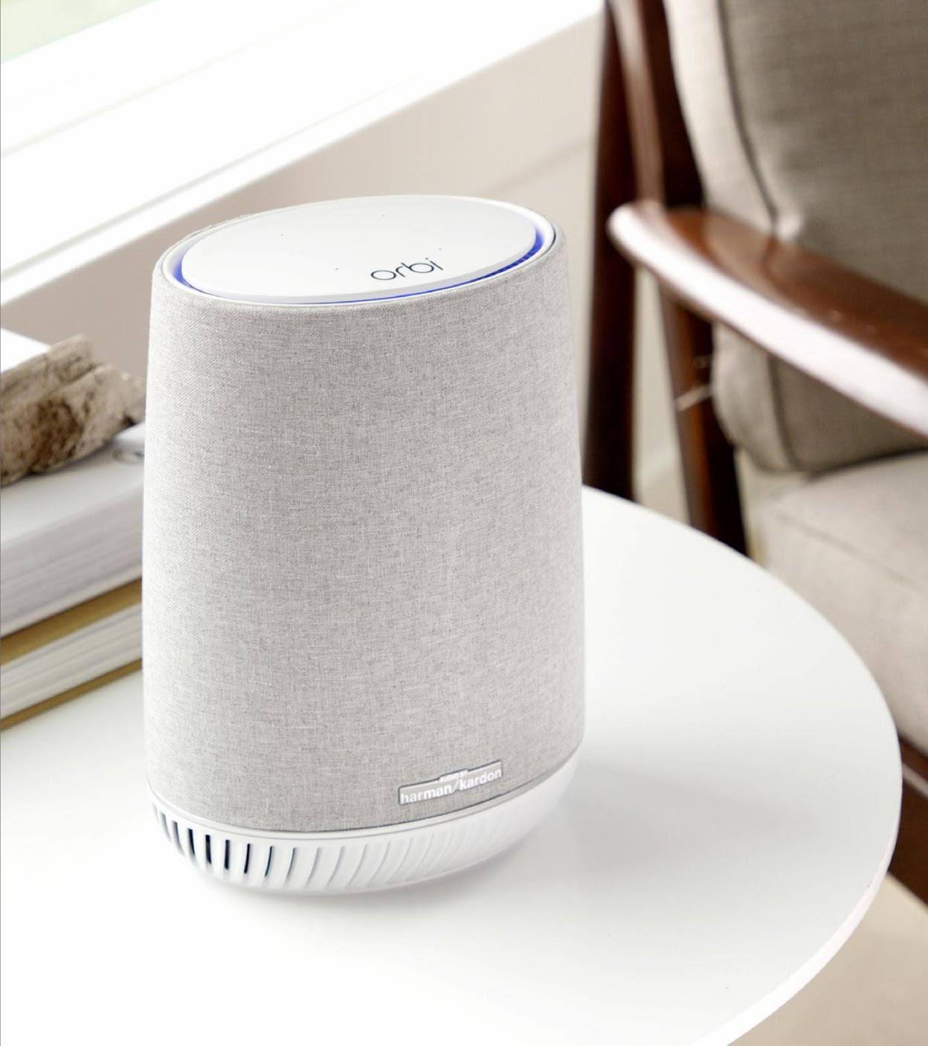
Agenda
Executive Summary
SKUs selected
Pareto 80/20 Analysis
Regression Analysis
Competitive Analysis
Recommendations
Q&A

Slide 3





Meet The Trojans
Mingyu Liao
MSBA 2019
Swapna Kutcharlapati
MBA 2020
Annie Song
MBA 2020
Financial Analysis, Business Intelligence, Data Mining, Web Analytics, and SAS Programming
Financial Planning and Analysis, Accounting, Valuation, Business Model, and Industry Analysis.
Gregy Thomas
MSBA 2019
Manasa Nelakuditi
MBA 2020
Product Management, Product Marketing, Growth Strategy, Branding, User Acquisition, SaaS Pricing
Machine Learning, Prescriptive Analytics,
Agile Scrum, and Product Management
Product Management, Software Development,
Web Applications, and Project Management

Slide 4
Executive Summary
1
Built a model to list the routers generating bottom 20% of profits.
2
Price elasticity and Cross Price elasticity across Product lines.
3
Conducted competitive analysis relative to 5 major competitors.

Slide 5
SKUs selected for Analysis
Model (SKU) | Group
R6900-200NAS | Group 1
R6900P-100NAS | Group 1
R7000-100NAS | Group 1
R7000P-100NAS | Group 1
R7800-100NAS | Group 1
R7900P-100NAS | Group 1
R8000-100NAS | Group 1
R8000P-100NAS | Group 1
R9000-100NAS | Group 1
XR500-100NAS | Group 1
R6350-100NAS | Group 2
R6400-100NAS | Group 2
R6700-100NAS | Group 2
R6020-100NAS | Group 3
R6080-100NAS | Group 3
R6120-100NAS | Group 3
R6220-100NAS | Group 3
R6230-100NAS | Group 3
R6260-100NAS | Group 3
WNDR3400-100NAS | Group 4
WNR2000-100NAS | Group 4
WNR3500L-100NAS | Group 4
Only included products sold in 2017 (Q1-Q4) and 2018 (Q1-Q3)
Only Included the SKUs suggested for routers
Regression considers data from 20 weeks (Aug – Dec 2018)
Cross elasticity compares SKUs within each group.
Group 1 – 11AC, Nighthawk - Best Group 2 – 11AC, mid-level pricing - Better Group 3 – 11AC, entry level pricing - Good Group 4 – 11n, oldest technology. It is economically priced.

Slide 6
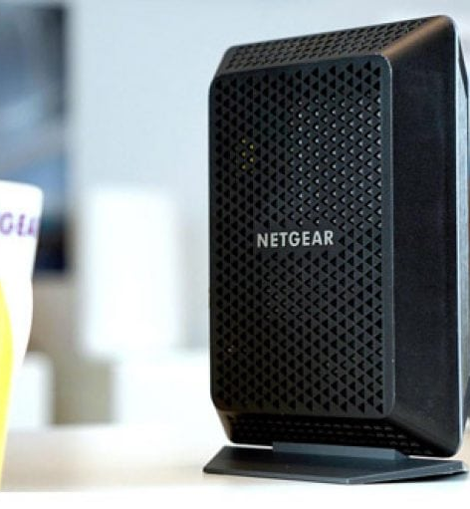
Pareto
Sales Margin
Standard Cost
Sales Thru Qty
Sales Thru Dollars

Slide 7
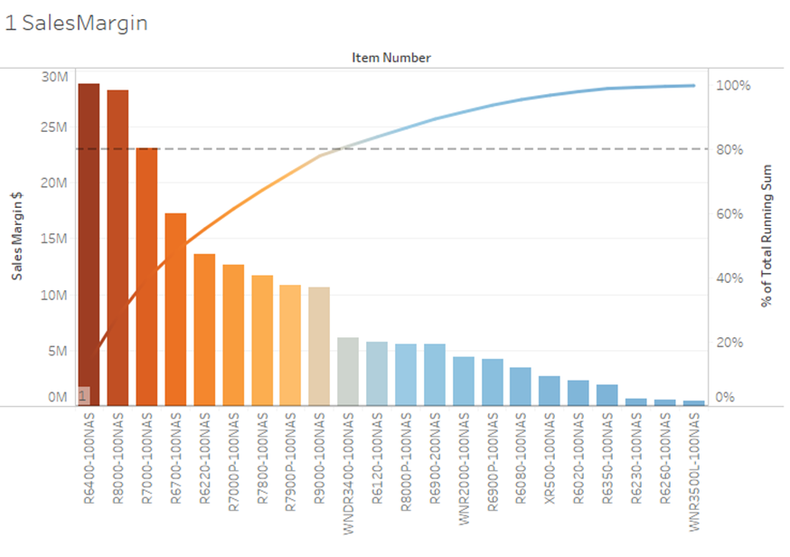
Routers Sales Margin
The top 80% sales margin contributed by:
6 Group1 items,48%
2 Group2 (r6400 and r6700) items - 25%
1 Group3(R6220)~6%
1 Group4(wndr3400)~3%
2

Slide 8
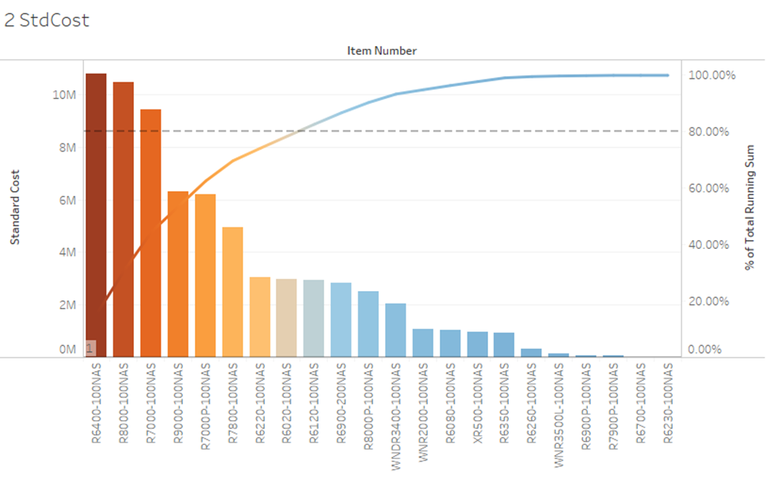
Routers Standard Cost
Top 80% Std Cost :
5 Group 1 – 54%
1 Group2 (r6400) -15%
3 Group3(r6220 , r6120 and r6020) - 12%

Slide 9
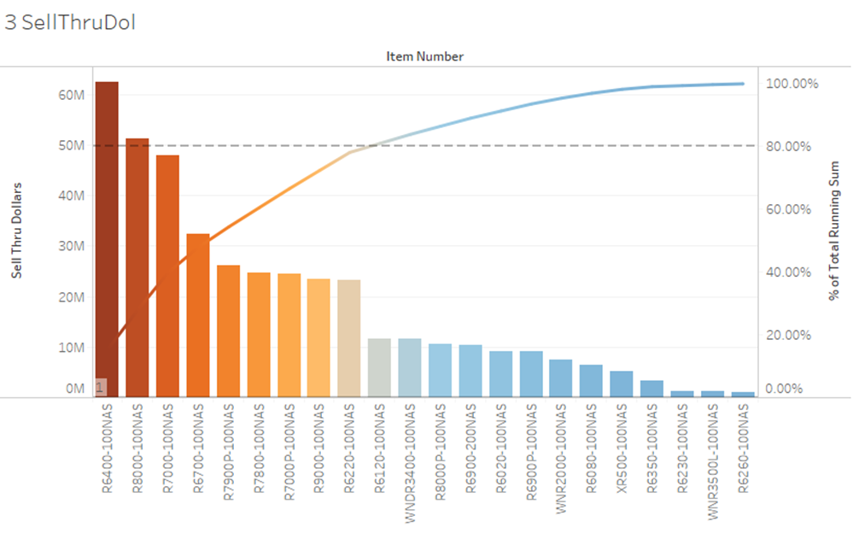
Routers Sell Thru Dollars
Top 80% Revenue generators include :
6 Group 1 – 48%-
2 Group2 (r6400 and r6700) - 23%
1 Group3 (r6220 and r6120) - 8%
1 Group4 (wndr3400) - 3%

Slide 10
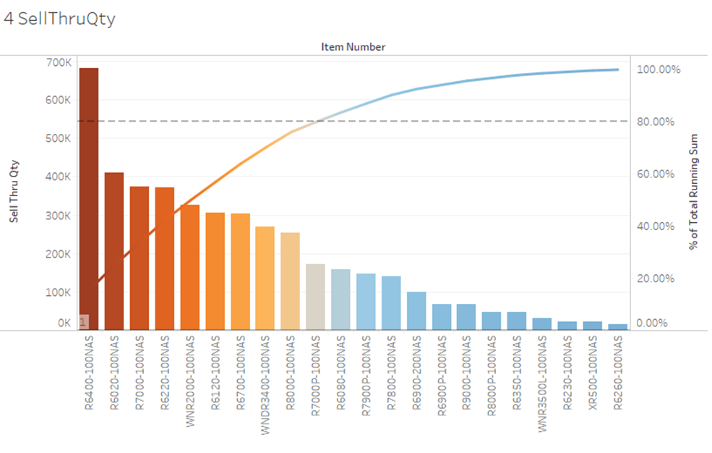
Routers Sell Thru Qty
Top 80% of Most Sold items include:
3 Group1 (r7000, r8000 and r7000P) --18%
2 Group2(r6400 and r6700) - 22%
3 Group3(r6020, r6220and r6120) - 25%
2 Group4(wnr2000 and wnr3400) - 13%

Slide 11
Router Trend Analysis
Revenue
Net Profit
Net Profit Percentile

Slide 12
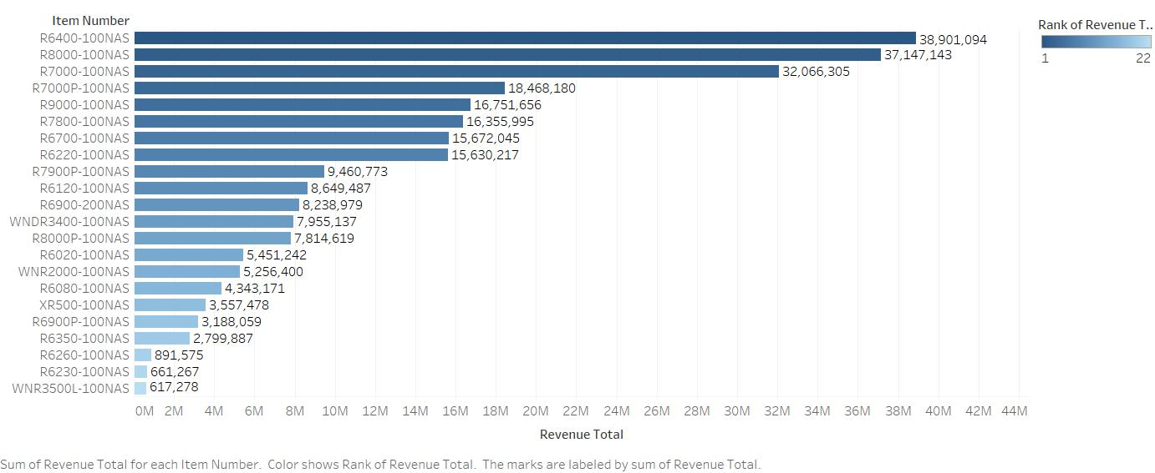
Router Item-wise Revenue Distribution
Bottom 20%
R6900P-100NAS
R6350-100NAS
R6260-100NAS
R6230-100NAS
WNR3500L-100NAS

Slide 13
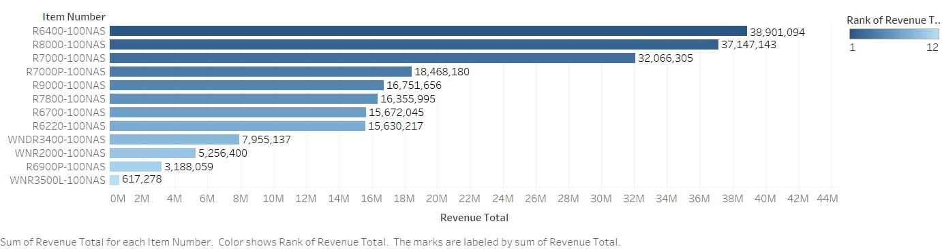
Router Item-wise Revenue Distribution
Bottom 20%
WNR2000-100NAS
R6900P-100NAS
WNR3500L-100NAS

Slide 14
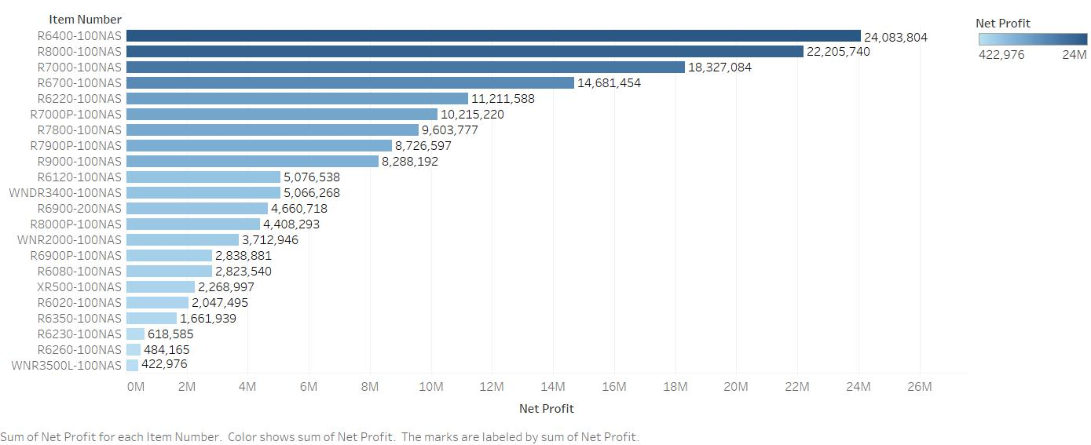
Router Item-wise Net Profit Distribution
Bottom 20%
R6020-100NAS
R6350-100NAS
R6230-100NAS
R6260-100NAS
WNR3500L-100NAS

Slide 15
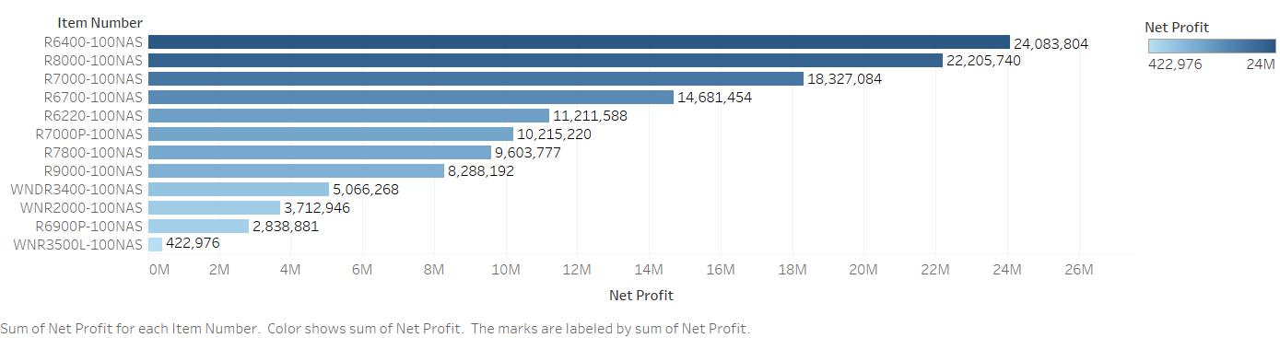
Router Item-wise Net Profit Distribution
Bottom 20%
WNR2000-100NAS
R6900P-100NAS
WNR3500L-100NAS

Slide 16
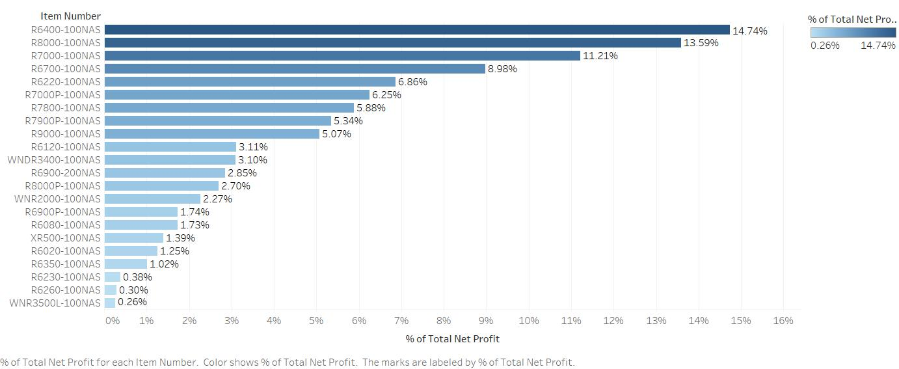
Router Item-wise Net Profit Percentile Distribution
Bottom 20%
R6020-100NAS
R6350-100NAS
R6230-100NAS
R6260-100NAS
WNR3500L-100NAS

Slide 17

Router Item-wise Net Profit Percentile Distribution
Bottom 20%
WNR2000-100NAS
R6900P-100NAS
WNR3500L-100NAS

Slide 18
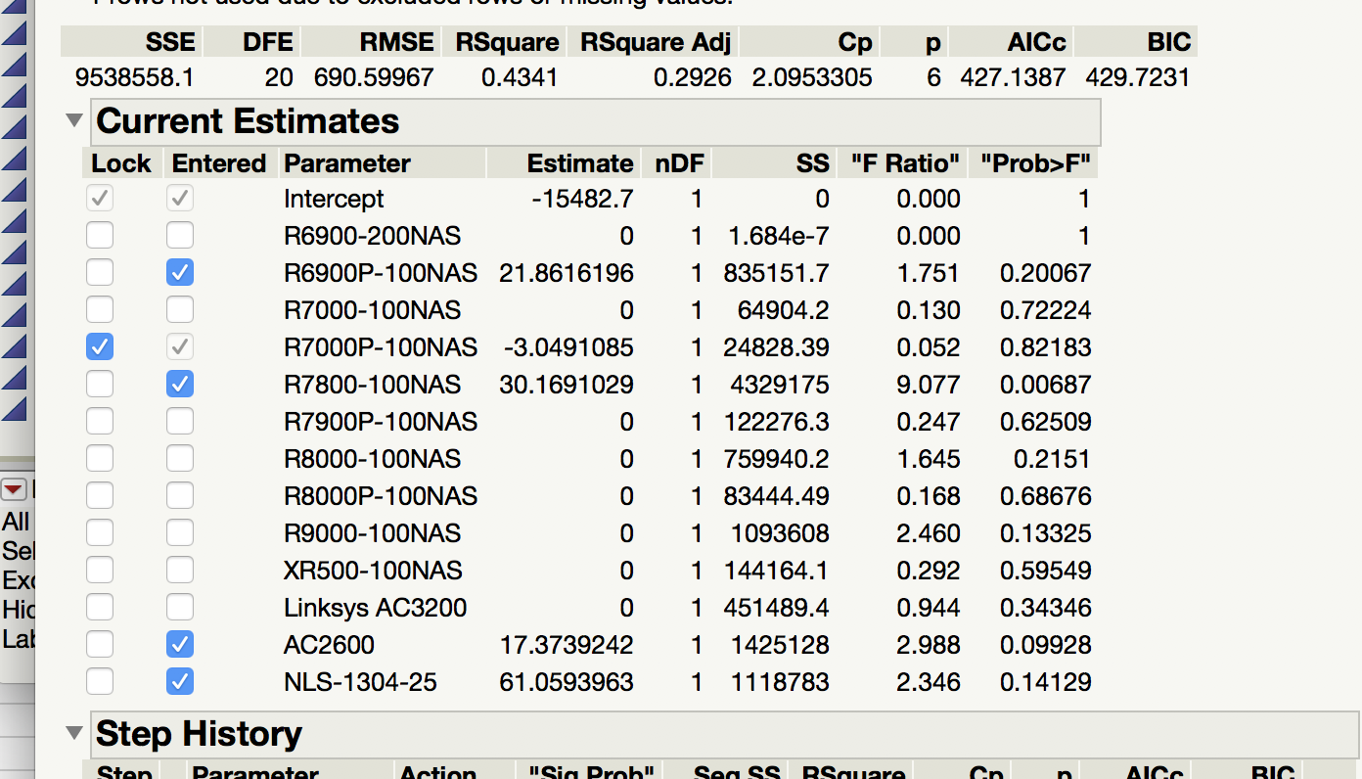
Price Elasticity – Routers Group 1

Slide 19
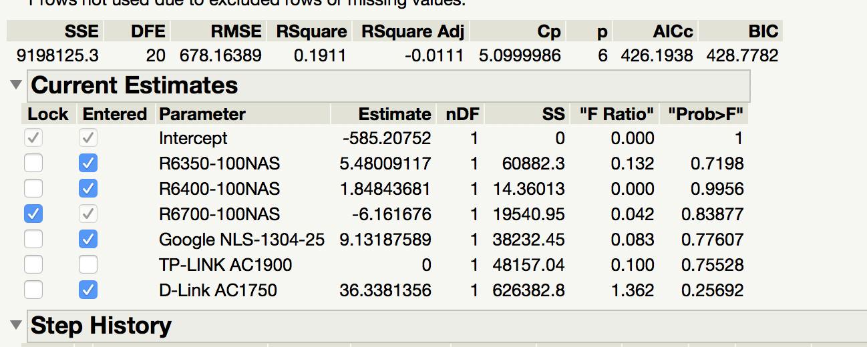
Price Elasticity – Routers Group 2

Slide 20
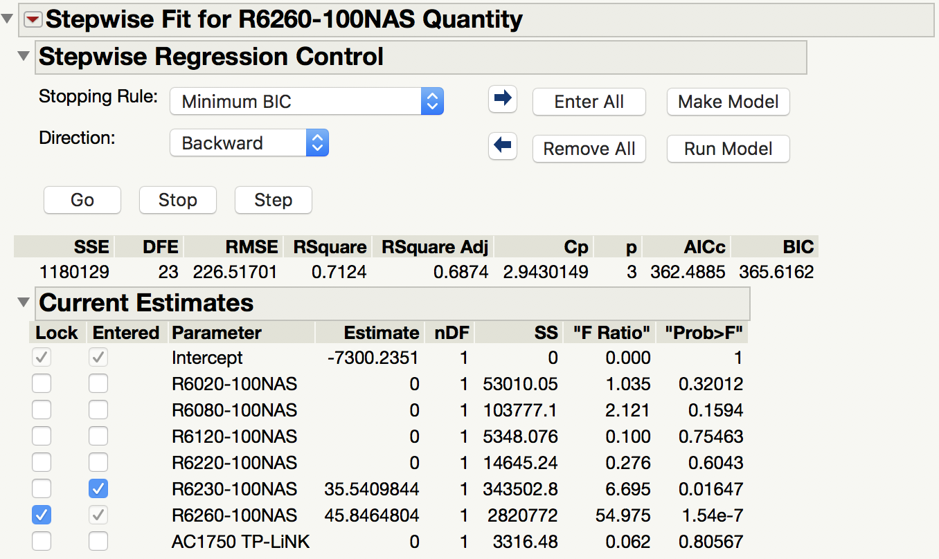
Price Elasticity – Routers Group 3

Slide 21
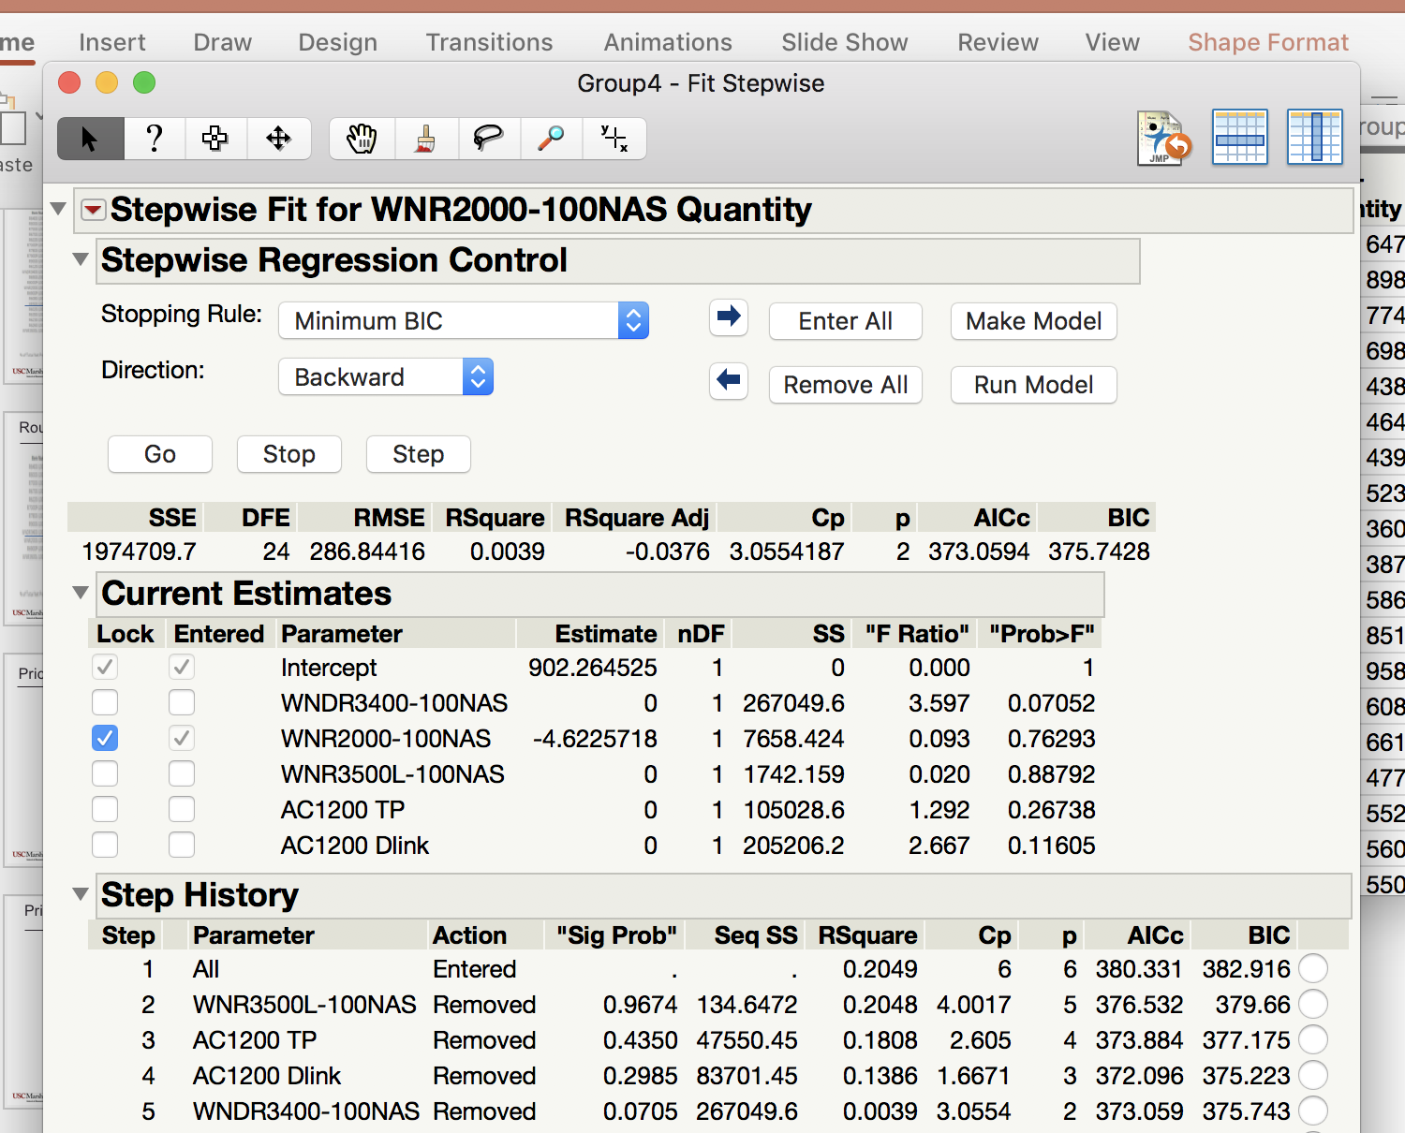
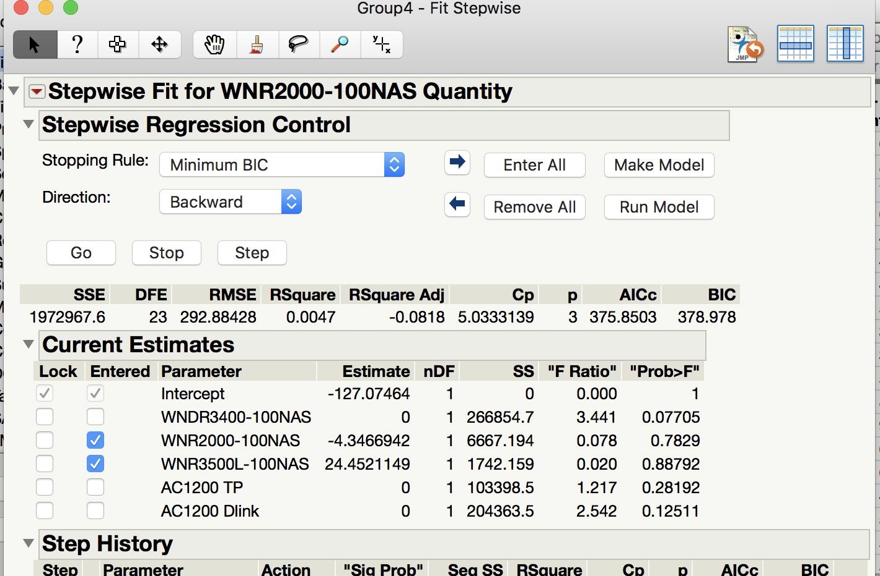
Price Elasticity – Routers Group 4

Slide 22
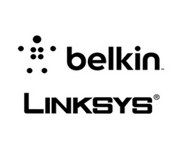


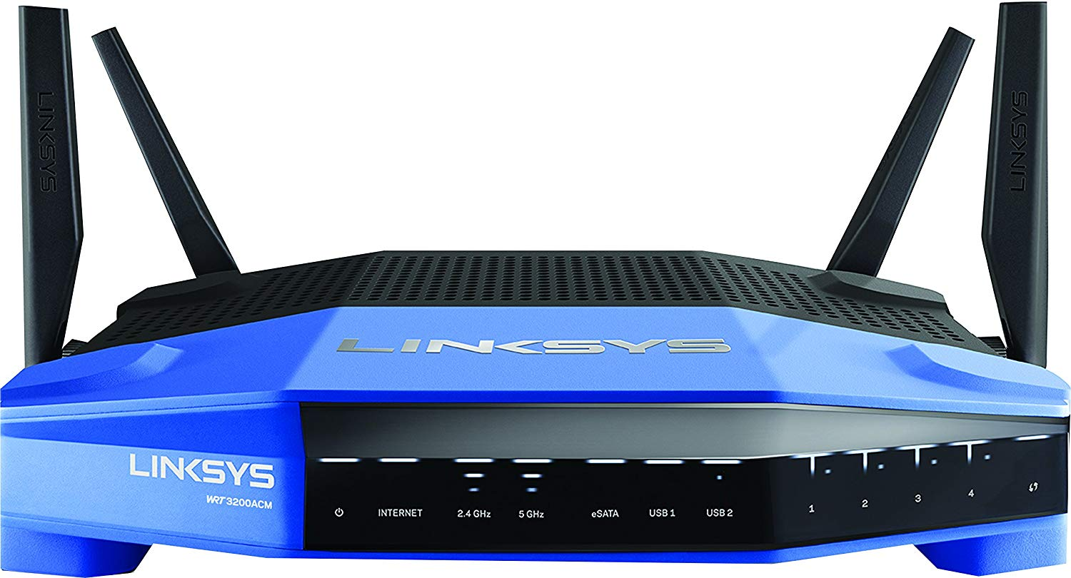
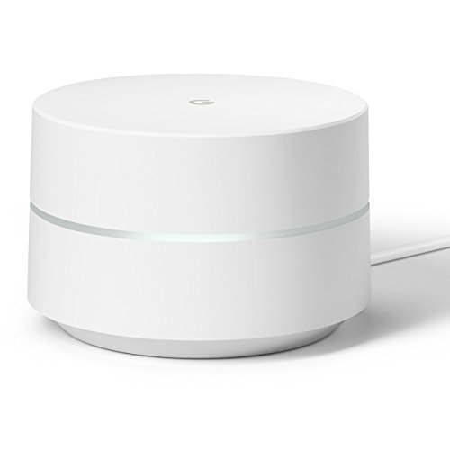
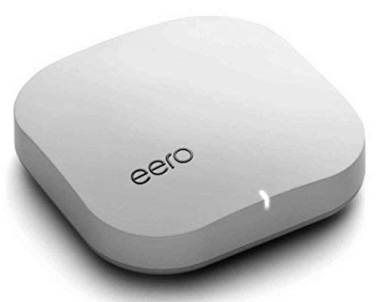
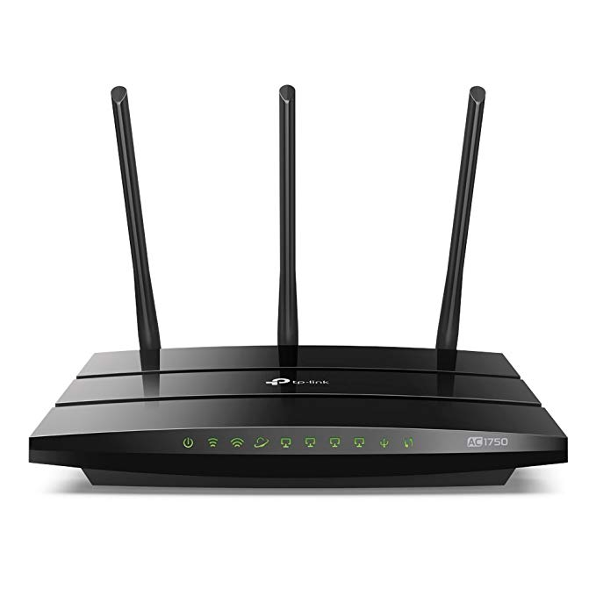
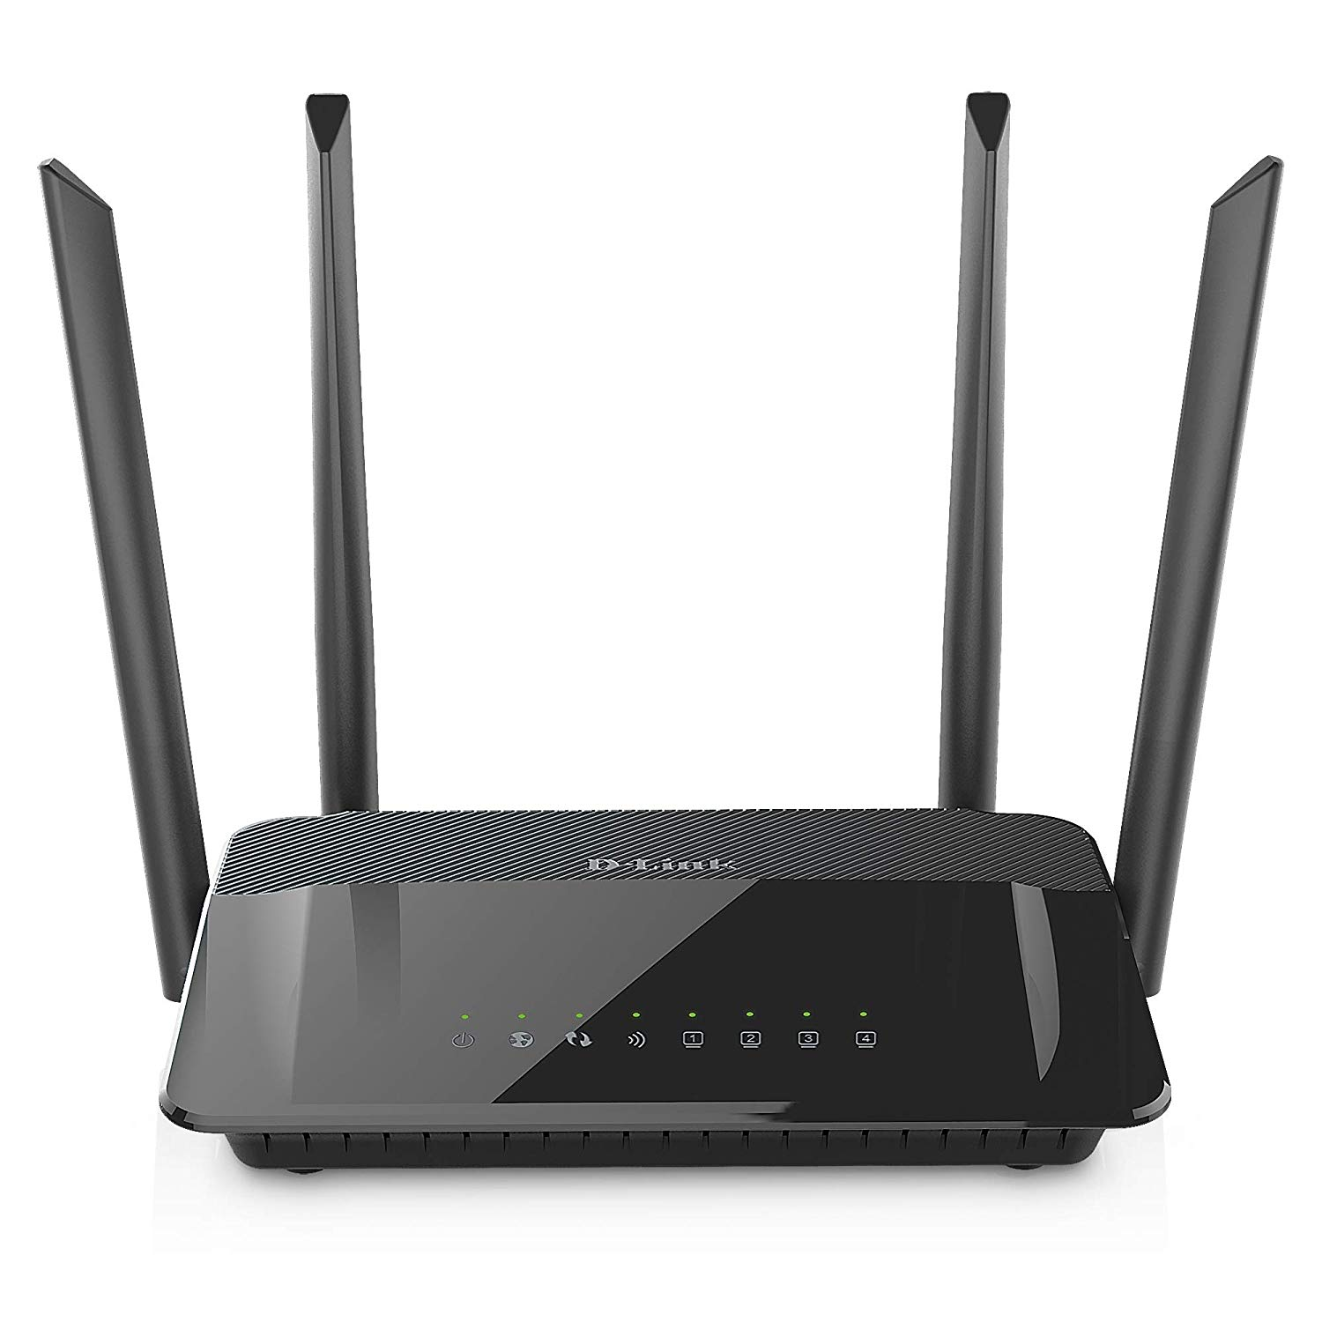


Competitors

Slide 23
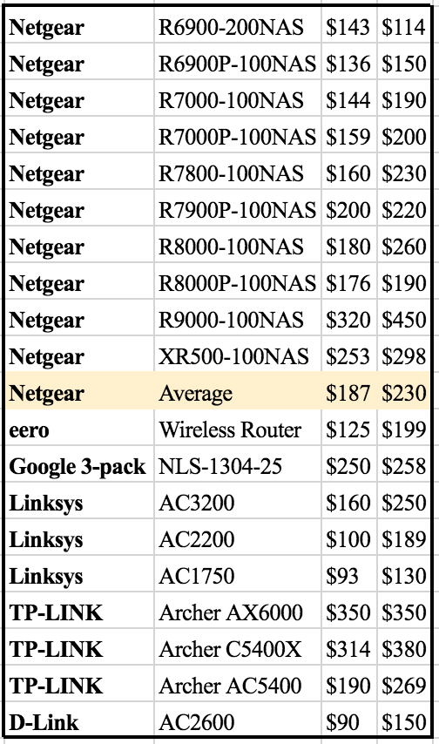
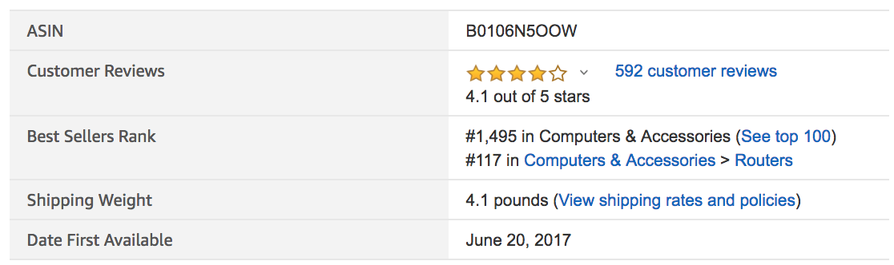
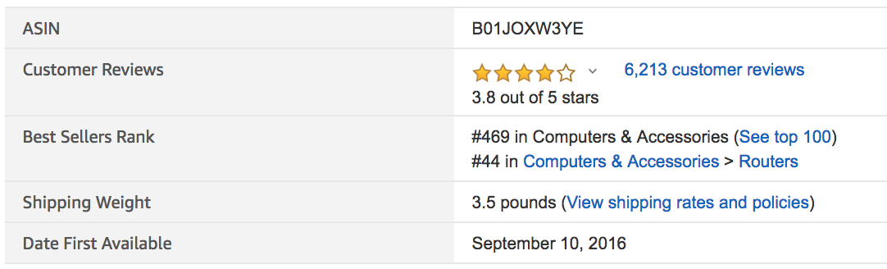
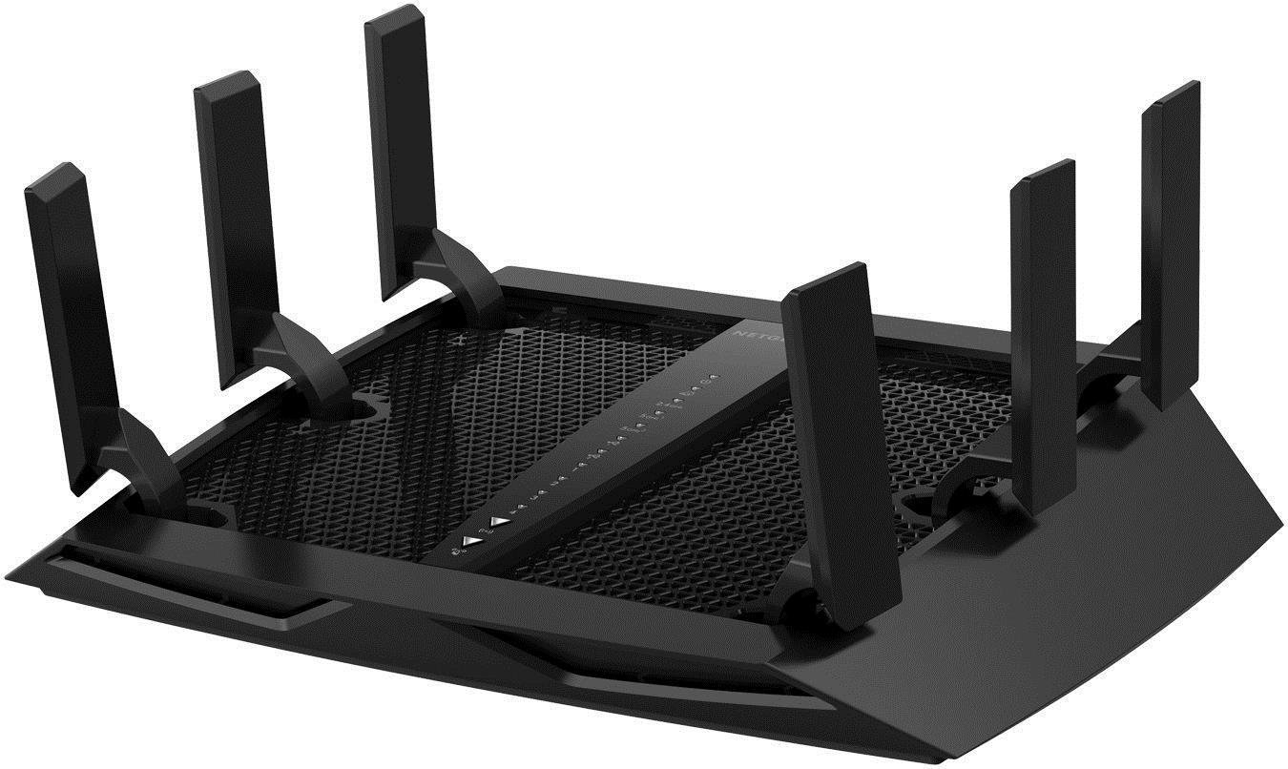
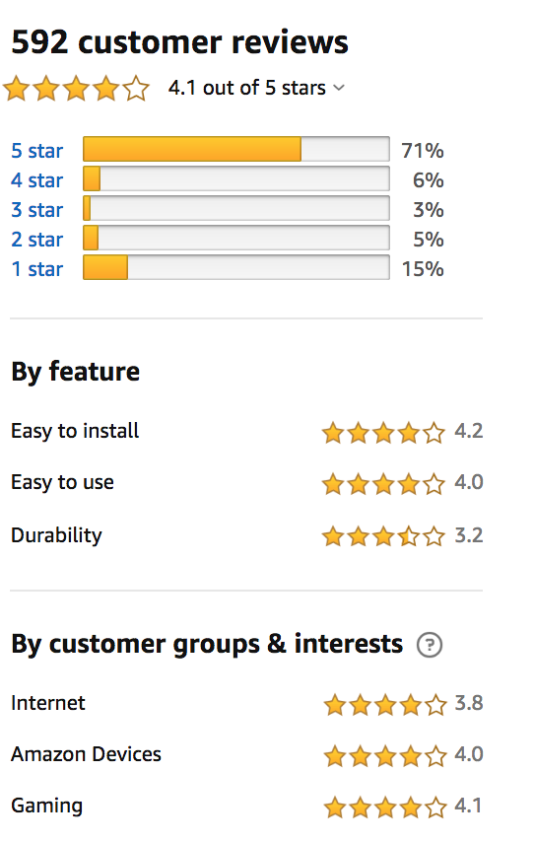
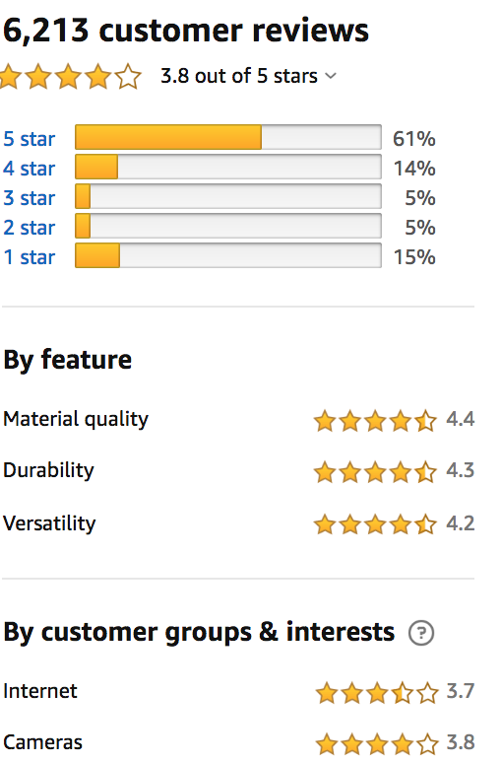
Competitors - Group 1
NETGEAR Nighthawk X6 AC3000 Dual Band Smart WiFi Router, Gigabit Ethernet, Compatible with Amazon Echo/Alexa (R7900)
Group 1: Nighthawk - Best
Linksys AC3200

Slide 24
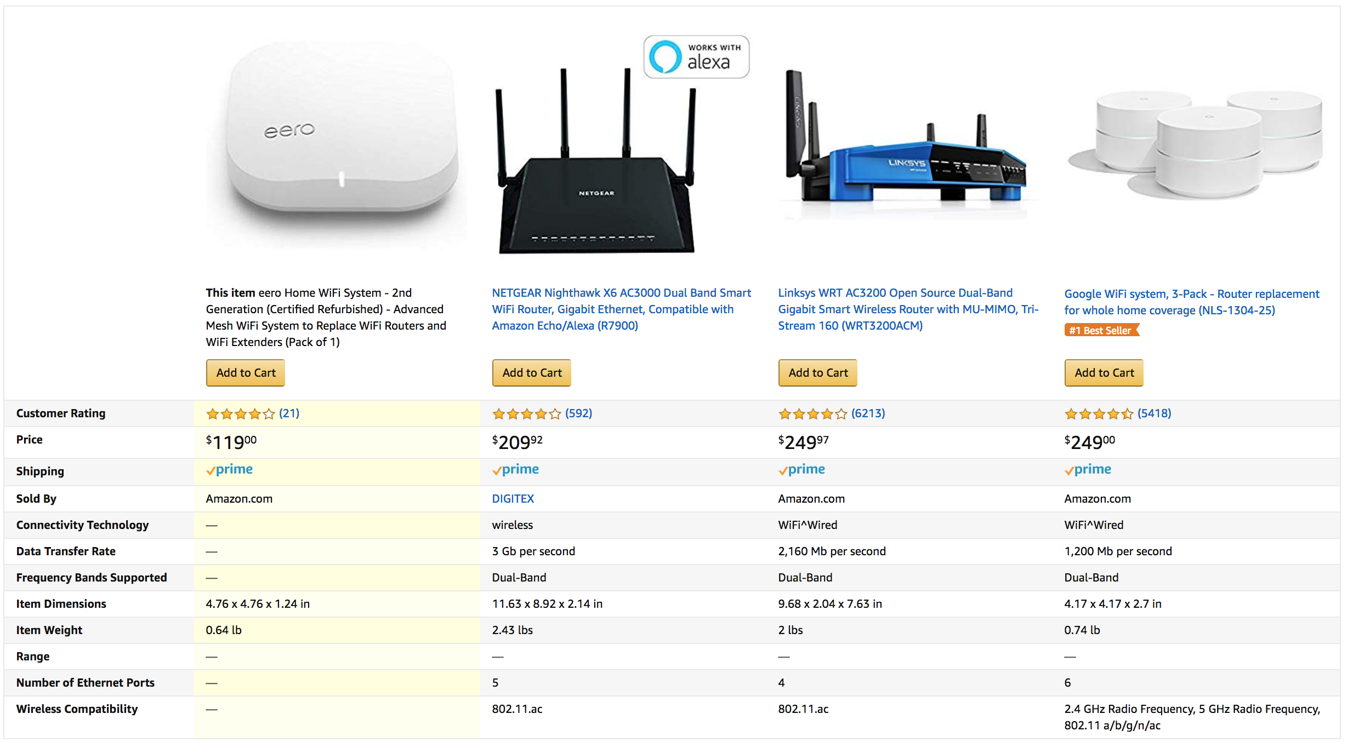
Competitors - Group 1 Contd.

Slide 25
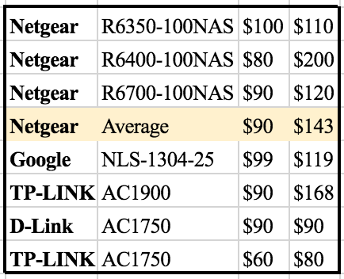
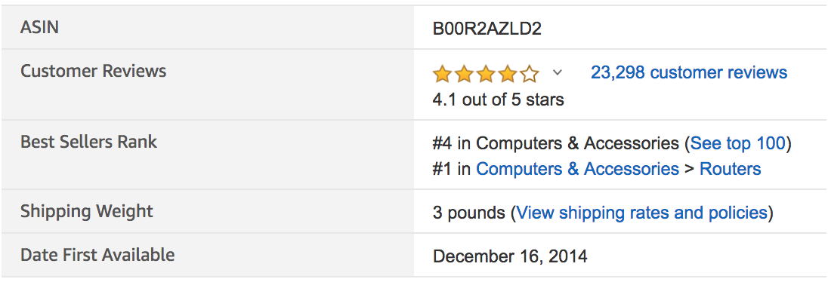
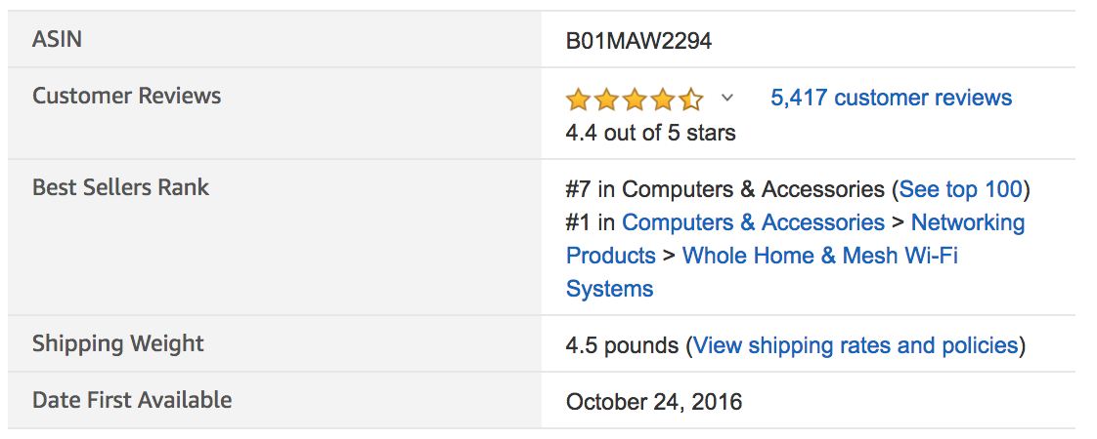
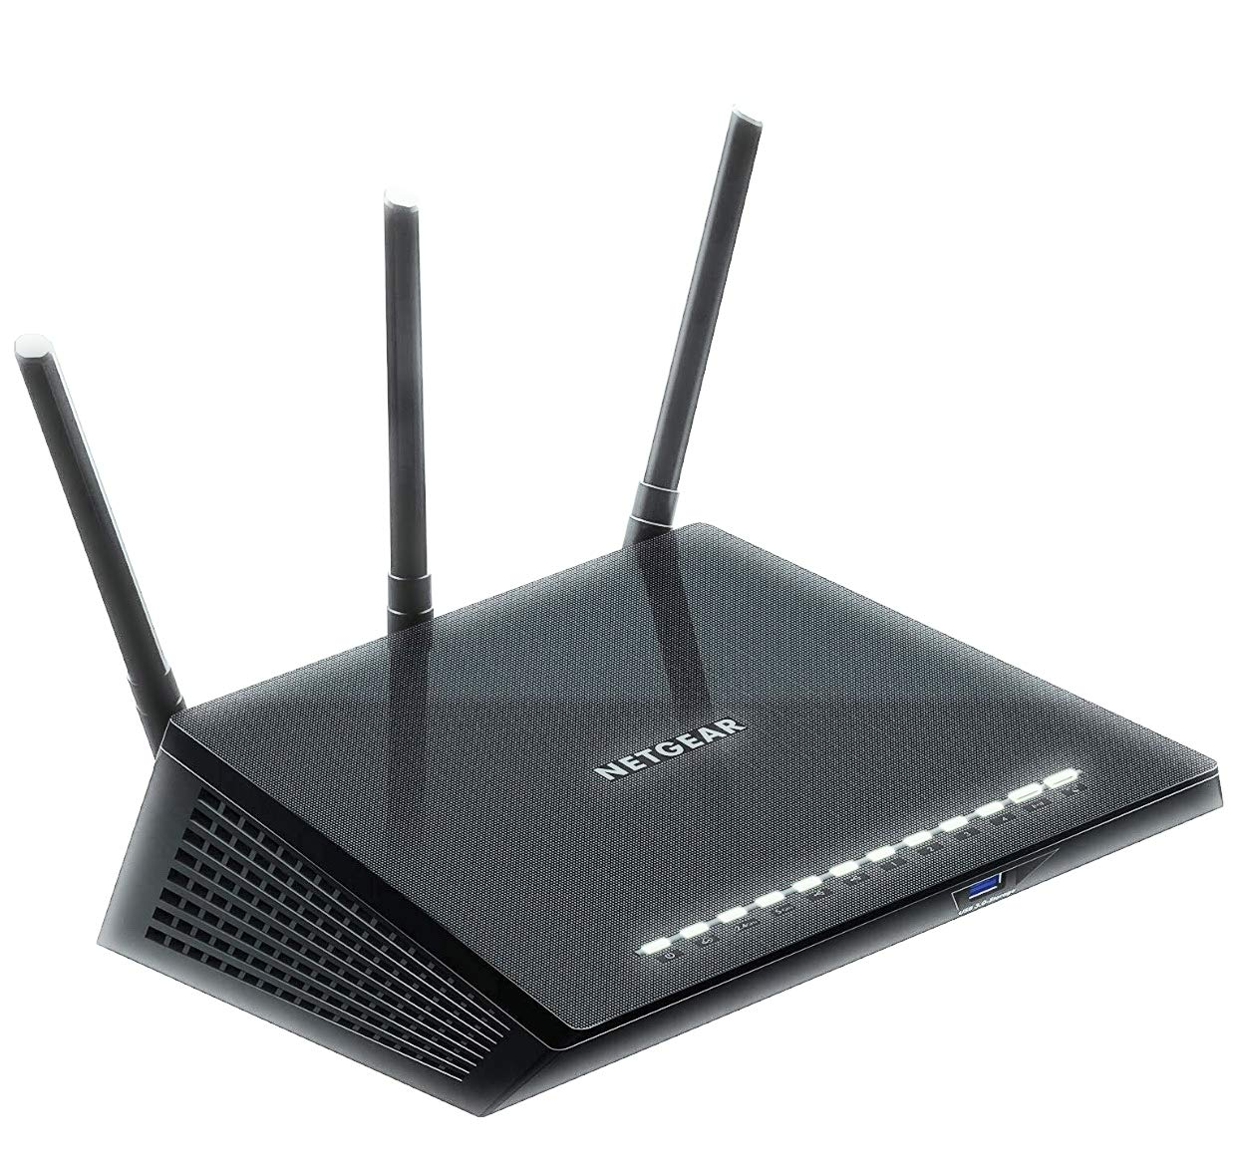
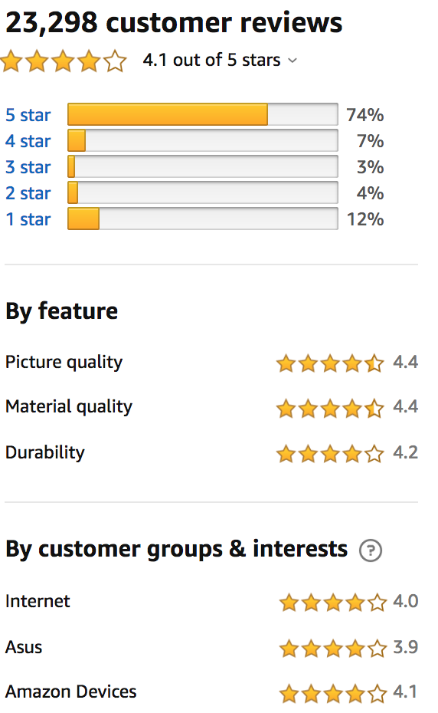
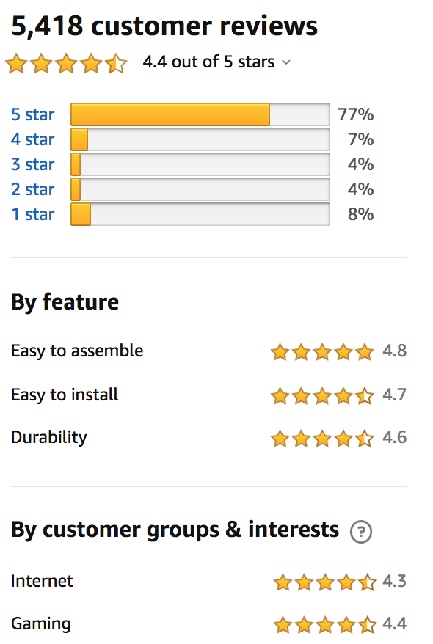
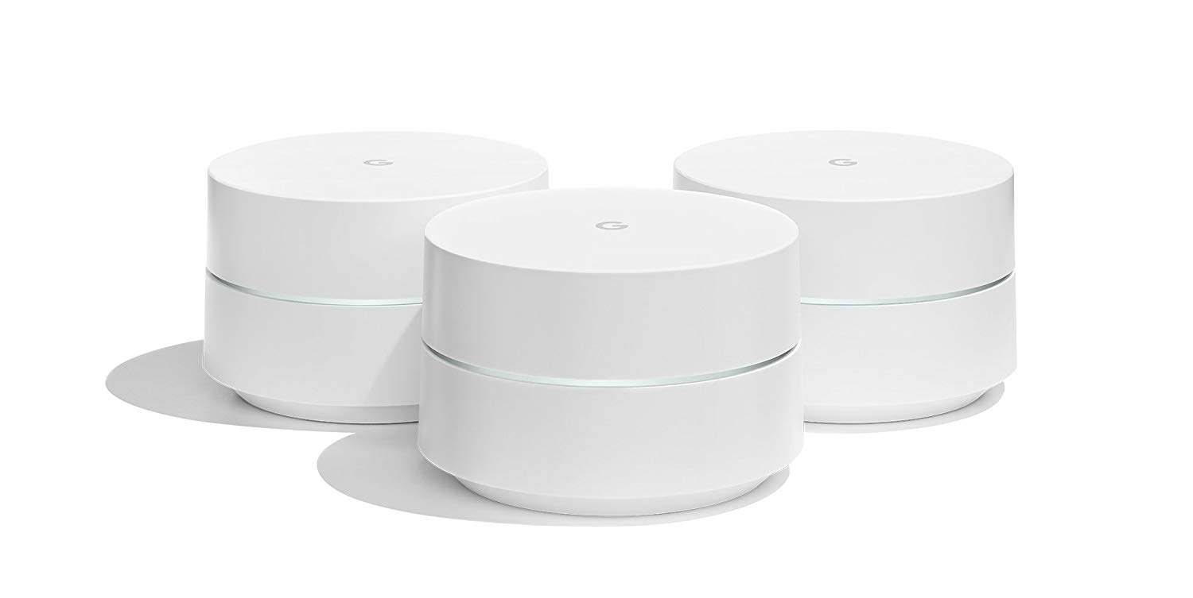
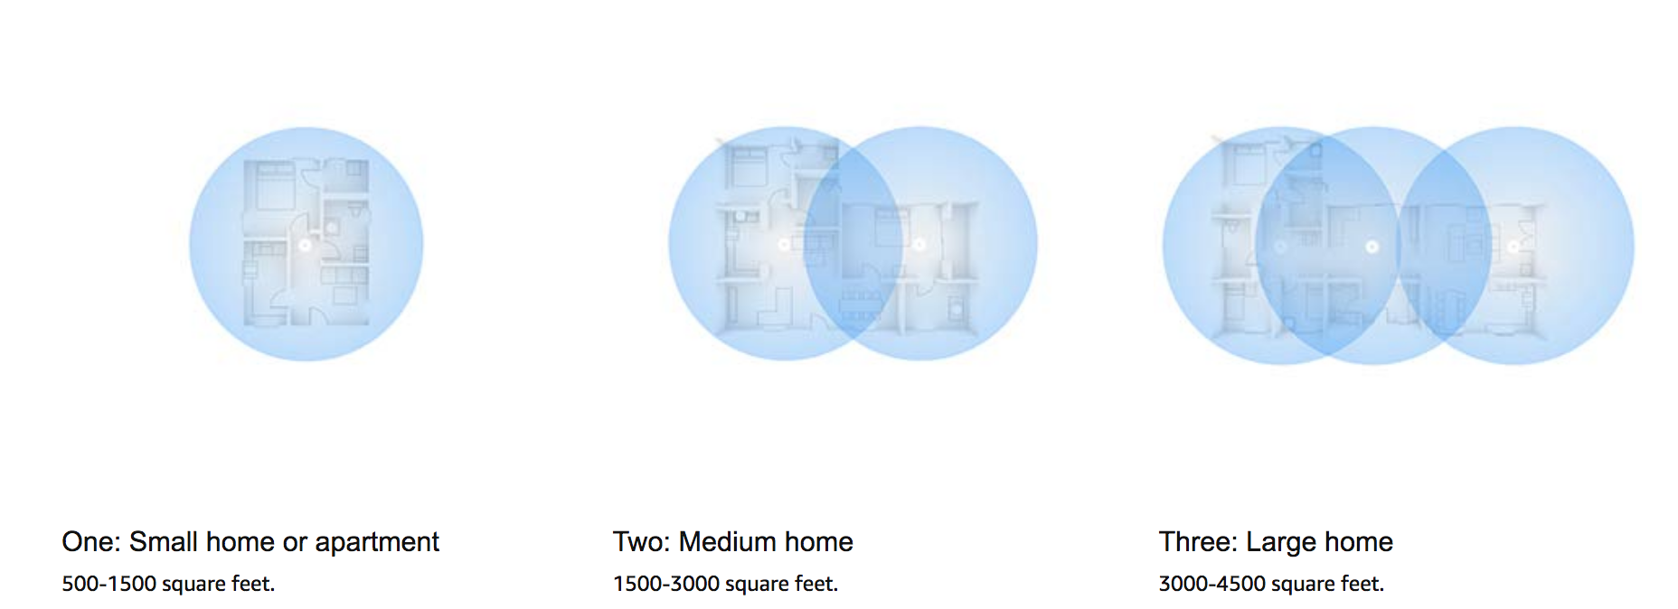
Competitors - Group 2 - Google
Group 2: Mid-level - Better
NETGEAR R6700 Nighthawk
Customer Support, Easy; Cost Variance

Slide 26
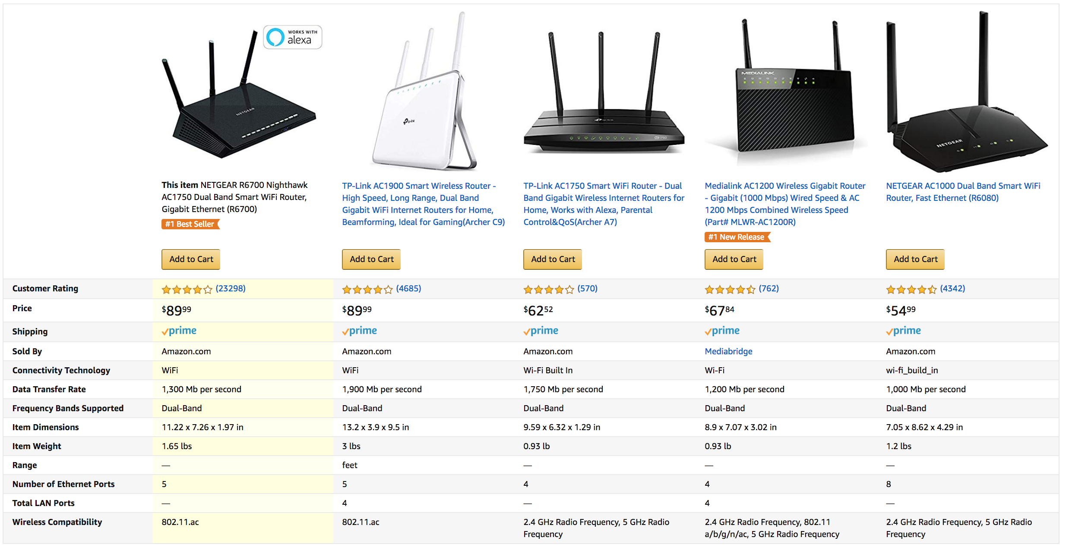
Competitors - Group 2 Contd.

Slide 27
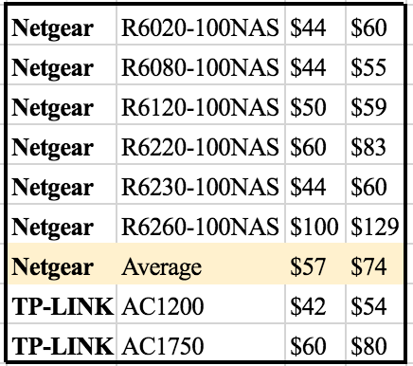
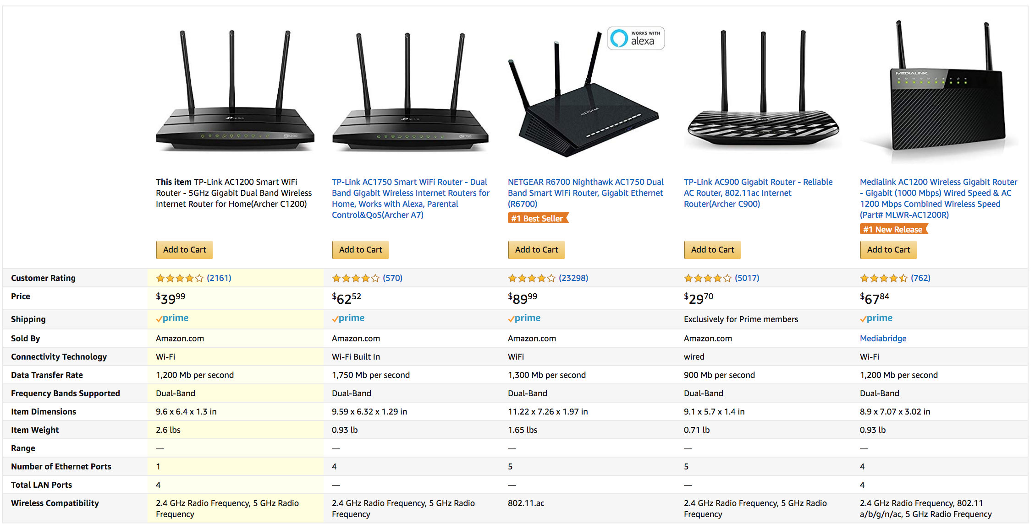
Competitors - Group 3 - TP-Link
Group 3: Entry-level - Good

Slide 28
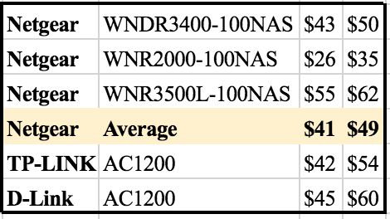
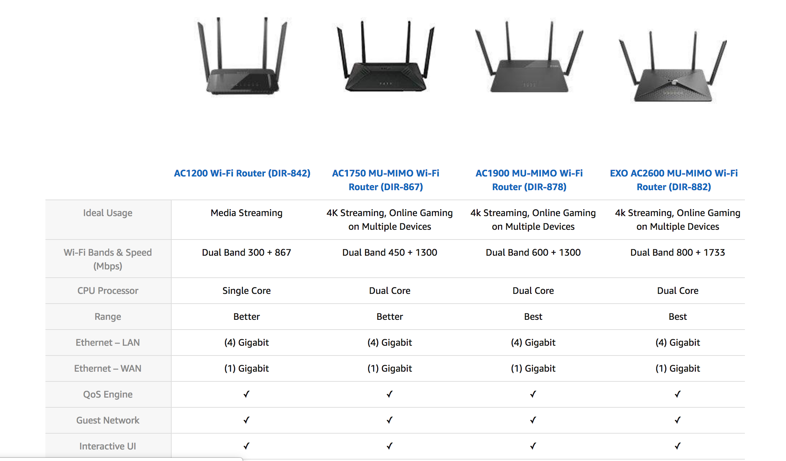
Competitors - Group 4 - D-Link
Group 4: Old Tech- Economic

Slide 29
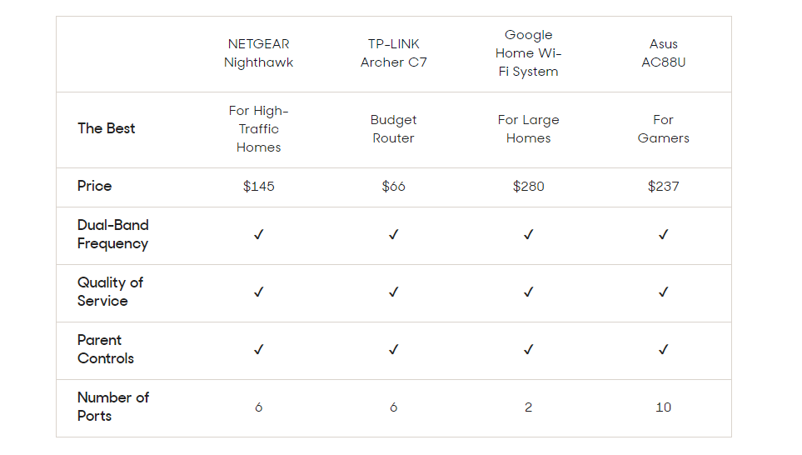
Customer Perception – Wireless Routers
Source - https://www.reviews.com/best-wireless-router/

Slide 30

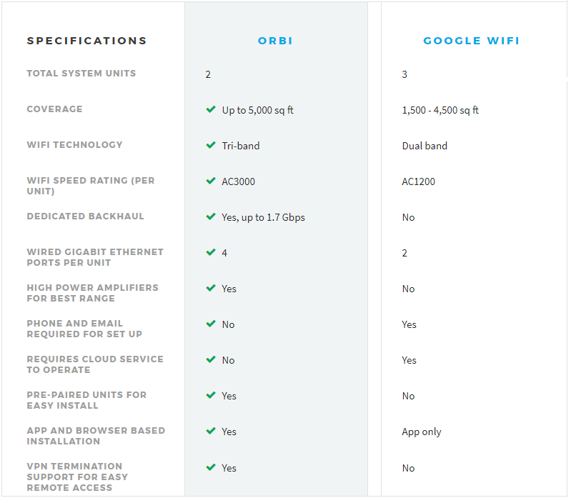
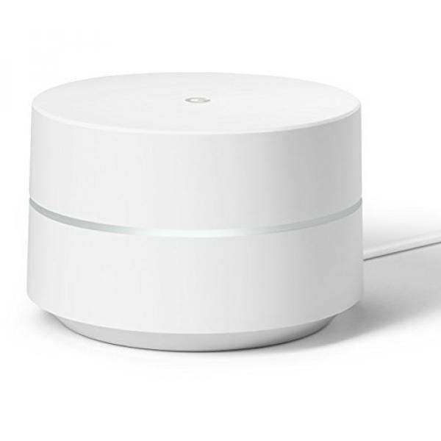
High-end Competition – Google Wi-Fi
+ MU-MIMO technology
+ Easy to install
+ Supports VPN
+ Compatible with Alexa
+ Includes Circle with Disney Smart Parental Controls
+ Can manage your WiFi from each device, mobile apps or via website
+ 1-year warranty
+ MU-MIMO technology + Easy to install
+ 24/7 tech support
+ Compatible with IFTTT + Allows you to pause WiFi on kids devices and block websites
+ Set up, manage WiFi, prioritize devices and more via mobile app
+ 1-year warranty
- Free tech support only for 90 days
- Must purchase modem separately
- Some users report unstable connections
- Lacks USB ports
- Can’t choose your band
- Must purchase modem separately
- Doesn’t support VPN

Slide 31
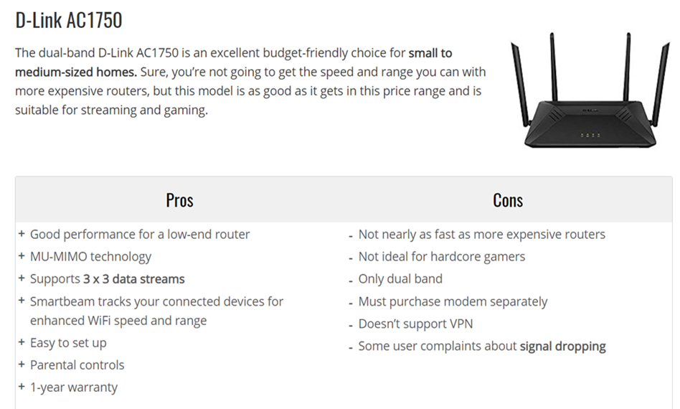
Budget Competition - Under $100

Slide 32

Recommendations
By looking at various products internally we realised the cannibalisation impact on few products
Group 4: WNR2000-100NAS Vs WNR 3500L-100NAS (winner)
Both qualitative and quantitative analysis predicts that our major competitors are TP Link and Google
To capture the low-end market, we need to develop routers with faster speed and cheaper price
To capture the high-end market, we need to enhance customer support and convey value created.

Slide 33
Thank You!

Slide 34

Appendix - Return Conversion Rates & Marketing Cost

